Slide 1
Logical Agents
Chapter 7
(based on slides from Stuart Russell and Hwee Tou Ng)

Slide 2
Logical Agents
Knowledge-based agents – agents that have an explicit representation of knowledge that can be reasoned with.
These agents can manipulate this knowledge to infer new things at the “knowledge level”

Slide 3
Outline
Knowledge-based agents
Wumpus world
Logic in general - models and entailment
Propositional (Boolean) logic
Equivalence, validity, satisfiability
Inference rules and theorem proving
  forward chaining
  backward chaining
  resolution

Slide 4

Knowledge bases
Knowledge base = set of sentences in a formal language
Declarative approach to building an agent (or other system):
  Tell it what it needs to know
Then it can Ask itself what to do - answers should follow from the KB
Agents can be viewed at the knowledge level - i.e., what they know, regardless of how implemented
Or at the implementation level
  i.e., data structures in KB and algorithms that manipulate them

Slide 5

A simple knowledge-based agent
The agent must be able to:
  Represent states, actions, etc.
  Incorporate new percepts
  Update internal representations of the world
  Deduce hidden properties of the world
  Deduce appropriate actions
Notes:
KB agent maintains a knowledge base which may initially contain background information. Each time the program is called, it (1) tells the KB what it perceives, (2) it asks the knowledge base what it should do, (3) it tells the KB what it does and time moves on…

Slide 6

A Wumpus World
Notes:
To get an idea of what a KB agent can do, let’s consider the Wumpus World.
A cave consisting of rooms connected by passageways. Lurking somewhere is a wumpus – a beast who eats anyone who enters the room. The wumpus stinks (and you can smell him a room away). Some rooms contain bottomless pits that will trap anyone who wanders in (there is a breeze in rooms next to the pit). The goal is to reach the gold (you know it is in the room because it glitters).

Slide 7
Wumpus World PEAS description
Performance measure
  gold +1000, death -1000
  -1 per step, -10 for using the arrow
Environment: 4 x 4 grid of rooms
  Squares adjacent to wumpus are smelly
  Squares adjacent to pit are breezy
  Glitter iff gold is in the same square
  Shooting kills wumpus if you are facing it
  Shooting uses up the only arrow
  Grabbing picks up gold if in same square
  Releasing drops the gold in same square
Sensors: Stench, Breeze, Glitter, Bump, Scream (shot Wumpus)
Actuators: Left turn, Right turn, Forward, Grab, Release, Shoot
Notes:
Agent always starts in square [1,1] facing right. Locations of the gold and the wumpus are chosen randomly (from squares other than the start square)

Slide 8
Wumpus world characterization
Fully Observable
Deterministic
Episodic
Static
Discrete
Single-agent?
Notes:
Fully Observable – does sensors give access to full state of the environment?

Slide 9
Wumpus world characterization
Fully Observable No – only local perception
Deterministic
Episodic
Static
Discrete
Single-agent?
Notes:
Deterministic – is the next state completely determined by the current state and the action executed by the agent or is there some uncertaintity?

Slide 10
Wumpus world characterization
Fully Observable No – only local perception
Deterministic Yes – outcomes exactly specified
Episodic
Static
Discrete
Single-agent?
Notes:
Episodic (or sequential) – episodic means divided into independent atomic episodes (like an assembly line robot where decisions about the current part does not affect the decision on the next part) or Sequential – where current action affects future environments.

Slide 11
Wumpus world characterization
Fully Observable No – only local perception
Deterministic Yes – outcomes exactly specified
Episodic No – sequential at the level of actions
Static
Discrete
Single-agent?
Notes:
Static or dynamic? Does the world change as time goes by?

Slide 12
Wumpus world characterization
Fully Observable No – only local perception
Deterministic Yes – outcomes exactly specified
Episodic No – sequential at the level of actions
Static Yes – Wumpus and Pits do not move
Discrete
Single-agent?
Notes:
Discrete versus continuous

Slide 13
Wumpus world characterization
Fully Observable No – only local perception
Deterministic Yes – outcomes exactly specified
Episodic No – sequential at the level of actions
Static Yes – Wumpus and Pits do not move
Discrete Yes
Single-agent?
Notes:
Vs multi-agent?

Slide 14
Wumpus world characterization
Fully Observable No – only local perception
Deterministic Yes – outcomes exactly specified
Episodic No – sequential at the level of actions
Static Yes – Wumpus and Pits do not move
Discrete Yes
Single-agent? Yes – Wumpus is essentially a natural feature

Slide 15
Wumpus World
Percepts given to the agent
Stench
Breeze
Glitter
Bumb (ran into a wall)
Scream (wumpus has been hit by arrow)
Principle Difficulty: agent is initially ignorant of the configuration of the environment – going to have to reason to figure out where the gold is without getting killed!
Notes:
Agent always starts in square [1,1] facing right. Locations of the gold and the wumpus are chosen randomly (from squares other than the start square).
Note the agent perceives the environment - percept looks like
[stench, breeze, glitter, bump, scream]
Let’s see how the knowledge-based agent would explore the world – trying to learn whether or not it can locate the gold without getting killed.

Slide 16
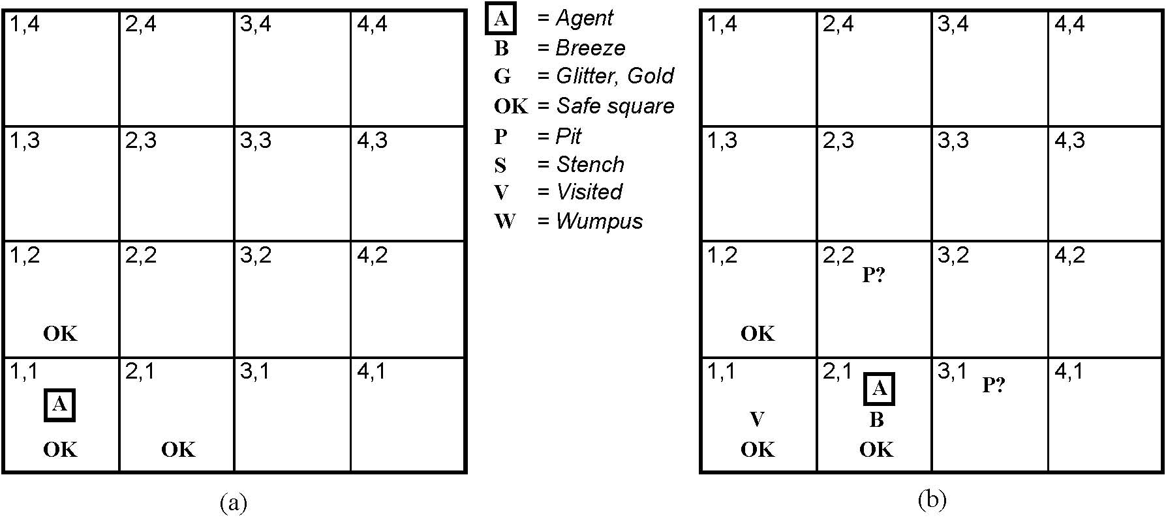
Exploring the Wumpus World
Initial situation:
Agent in 1,1 and percept is
[None, None, None, None, None]
From this the agent can infer the neighboring squares are safe (otherwise there would be a breeze or a stench)
Notes:
We will mark down what we know – initially the agent (A) is in 1,1, and we know that that square is OK.
It then gets the first percept – remember order is
[stench, breeze, glitter, bump, scream] – and first percept has these all null.
A cautious agent will move only into a square it knows to be OK.

Slide 17

Exploring a wumpus world
Notes:
In initial state, there are no percepts (the sequence is none, none, none, none, none) and therefore it can be inferred that the neighboring squares are safe (OK).

Slide 18

Exploring a wumpus world
Notes:
The agent decides to move up and feels a breeze – what does this mean?

Slide 19

Exploring a wumpus world
Notes:
That there is a pit in either of the two neighboring squares. Better not move there since it knows there is a safer move if it backs up…

Slide 20

Exploring a wumpus world
Notes:
So it does – and what can it infer from there?

Slide 21

Exploring a wumpus world
Notes:
A pretty difficult inference!; note how difficult because of the inference of where the pit is depends on the lack of a percept (no B in 2,1) and percepts gathered over time.

Slide 22

Exploring a wumpus world

Slide 23

Exploring a wumpus world

Slide 24

Exploring a wumpus world
Notes:
The agent wins!

Slide 25
Exploring a wumpus world
In each case where the agent draws a conclusion from the available
Information, that conclusion is guaranteed to be correct if the available
Information is correct…
This is a fundamental property of logical reasoning
Notes:
The agent wins!

Slide 26
Logic in general
Logics are formal languages for representing information such that conclusions can be drawn
Syntax defines how symbos can be put together to form the sentences in the language
Semantics define the "meaning" of sentences;
  i.e., define truth of a sentence in a world (given an interpretation)
E.g., the language of arithmetic
  x+2 ≥ y is a sentence; x2+y > {} is not a sentence
  x+2 ≥ y is true iff the number x+2 is no less than the number y
  x+2 ≥ y is true in a world where x = 7, y = 1
  x+2 ≥ y is false in a world where x = 0, y = 6
Notes:
Let’s see how we can do that kind of reasoning.
In order to have a logic, we need to have a couple of things…
In standard logics, every sentence must be either true or false in each possible world – there is no in between.

Slide 27
Entailment
Entailment means that one thing follows logically from another:
KB ╞ α
Knowledge base KB entails sentence α if and only if α is true in all worlds where KB is true
  E.g., the KB containing “the Phillies won” and “the Reds won” entails “Either the Phillies won or the Reds won”
  E.g., x+y = 4 entails 4 = x+y
  Entailment is a relationship between sentences (i.e., syntax) that is based on semantics
Notes:
Here you want to see a possible world as a mapping of the sentences into t or f in the possible world.

Slide 28

Models
Logicians typically think in terms of models, which are formally structured worlds with respect to which truth can be evaluated
We say m is a model of a sentence α if α is true in m
M(α) is the set of all models of α
Then KB ╞ α iff M(KB) ⊆ M(α)
  E.g. KB = Phillies won and
  Yankees won α = Phillies won

Slide 29

Entailment in the wumpus world
Situation after detecting nothing in [1,1], moving right, breeze in [2,1]
Consider possible models for KB assuming only pits
3 Boolean choices ⇒ 8 possible models
Notes:
The percepts and the agent’s knowledge of the rules of the game (from the PEAS description) constitute the KB. The agent wants to know if the adjacent squares contain pits. Each may or may not contain a pit – so

Slide 30

Wumpus possible models
Notes:
Although the figure shows possible wumpus worlds, they are really nothing more than assignments of true and false to the sentences “there is a pit in …” [1,2], [2,2], [3,1]

Slide 31

Wumpus models
KB = wumpus-world rules + observations
Notes:
The KB is false in models that contradict what the agent knows – there are just 3 models in which the KB is true. Go through and recognize why… both the true and the false cases.
e.g., KB is false in any models in which [1,2] contains a pit, because there is no breeze in [1,1]

Slide 32

Wumpus models
KB = wumpus-world rules + observations
α₁ = “there is no pit in [1,2]", KB ╞ α₁, proved by model checking
Notes:
Model checking – enumerate all possible models, and check to see that alpha is true in all models in which KB is true (and then it must be the case that the KB entails alpha).

Slide 33
Wumpus models
KB = wumpus-world rules + observations

Slide 34

Wumpus models
KB = wumpus-world rules + observations
α₂ = “there is no pit in [2,2]", KB ╞ α₂

Slide 35
Inference and Entailment
Inference is a procedure that allows new sentences to be derived from a knowledge base.
Understanding inference and entailment: think of
  Set of all consequences of a KB as a haystack
  α as the needle
Entailment is like the needle being in the haystack
Inference is like finding it
Notes:
So, these examples not only show entailment, but also how entailment can be used to derive conclusions.

Slide 36
Inference
KB ├_{i} α = sentence α can be derived from KB by inference procedure I
Soundness: i is sound if whenever KB ├_{i} α, it is also true that KB╞ α
Completeness: i is complete if whenever KB╞ α, it is also true that KB ├_{i} α
Preview: we will define a logic (first-order logic) which is expressive enough to say almost anything of interest, and for which there exists a sound and complete inference procedure.
That is, the procedure will answer any question whose answer follows from what is known by the KB.
Notes:
Alpha is derived from KB by i

Slide 37
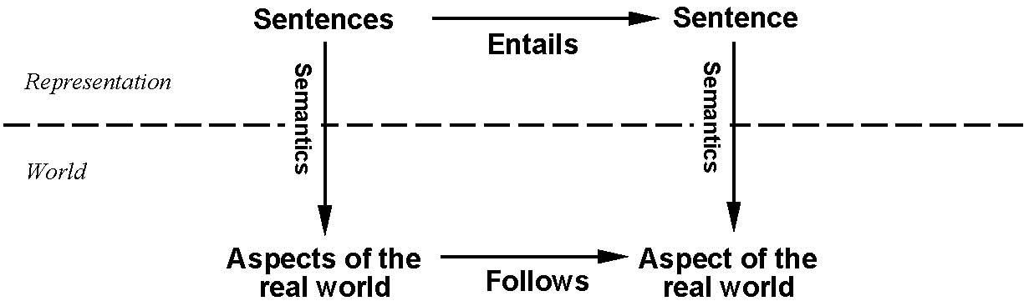
Step Back…
This is an inference procedure whose conclusions are guaranteed to be true
In any world where the premises are true.
If KB is true in the real world, then any sentence α derived
from KB by a sound inference procedure is also true in
the real world.
Notes:
We have described an inference procedure whose conclusions are guaranteed to be true in any world in which the premises are true.
Note – the inference procedure operates on syntax – and we can conclude things about the semantics of other sentences in the real world – a very powerful thing.

Slide 38
Propositional logic: Syntax
Propositional logic is the simplest logic – illustrates basic ideas
The proposition symbols P₁, P₂ etc are (atomic) sentences
  If S is a sentence, ¬(S) is a sentence (negation)
  If S₁ and S₂ are sentences, (S₁ ∧ S₂) is a sentence (conjunction)
  If S₁ and S₂ are sentences, (S₁ ∨ S₂) is a sentence (disjunction)
  If S₁ and S₂ are sentences, (S₁ ⇒ S₂) is a sentence (implication)
  If S₁ and S₂ are sentences, (S₁ ⇔ S₂) is a sentence (biconditional)
Notes:
Let’s show a simple but powerful logic – called propositional logic. In defining a logic we need to specify its syntax and its semantics – and then we can look at entailment.
Syntax defines allowable sentences. Atomic sentences (propositions) are the smallest bit of thing that one could be “true” or “false”. T and F (true and false) are propositional sentences. From these we use connectives to build up more complicated sentences… I have shown the () here, but they can be dropped w/o loss of generality if we define a precedence order on the operators with not having the highest precedence. Notice the recursive definition.

Slide 39
Propositional logic: Semantics
Each model specifies true/false for each proposition symbol
  E.g. P_{1,2} P_{2,2} P_{3,1}
  false true false
With these symbols, 8 possible models, can be enumerated automatically.
Rules for evaluating truth with respect to a model m:
¬S is true iff S is false
S₁ ∧ S₂ is true iff S₁ is true and S₂ is true
S₁ ∨ S₂ is true iff S₁is true or S₂ is true
S₁ ⇒ S₂ is true iff S₁ is false or S₂ is true
i.e., is false iff S₁ is true and S₂ is false
S₁ ⇔ S₂ is true iff S₁⇒S₂ is true andS₂⇒S₁ is true
Simple recursive process evaluates an arbitrary sentence, e.g.,
¬P_{1,2} ∧ (P_{2,2} ∨ P_{3,1}) = true ∧ (true ∨ false) = true ∧ true = true
Notes:
The semantics defines the rules for determining the truth of a sentence with respect to a particular model – a mapping of the atomic symbols into true and false. The semantics of a logic must say how to compute the truth value of any sentence, given a model.
This is done recursively – by specifying how to compute the semantics of sentences using the 5 connectives.

Slide 40

Truth tables for connectives
Notes:
Using the tables, we can compute the truth value of a complex sentence recursively (as we saw on the previous slide).

Slide 41
Truth tables for connectives
John likes football and John likes baseball.
John likes football or John likes baseball.
(English or is a bit different…)
Notes:
Notice some intuitions with respect to corresponding English sentences:

Slide 42
Truth tables for connectives
John likes football and John likes baseball.
John likes football or John likes baseball.
If John likes football then John likes baseball.
(Note different from English – if John likes football maps to false, then the sentence is true.)
(Implication seems to be if antecedent is true then I claim the consequence is, otherwise I make no claim.)
Notes:
Notice some intuitions with respect to corresponding English sentences:

Slide 43
Wumpus world sentences
Let P_{i,j} be true if there is a pit in [i, j].
Let B_{i,j} be true if there is a breeze in [i, j].
  ¬ P_{1,1}
  ¬B_{1,1}
  B_{2,1}
"Pits cause breezes in adjacent squares“
B_{2,1} ⇔ (P_{1,1} ∨ P_{2,2} ∨ P_{3,1})
B1,1  (P1,2  P2,1)

Slide 44
Simple Inference Procedure
KB╞ α?
Model checking – enumerate the models, and check if α is true in every model in which KB is true. Size of truth table depends on # of atomic symbols.
Remember – a model is a mapping of all atomic symbols to true or false – use semantics of connectives to come to an interpretation for them.

Slide 45

Truth tables for inference
Notes:
This is taken from the text – meant to show how you need to enumerate all possibilities – then look in the lines of the table where the KB is true.

Slide 46

Inference by enumeration
Depth-first enumeration of all models is sound and complete
For n symbols, time complexity is O(2^{n}), space complexity is O(n)

Slide 47

Logical equivalence
Two sentences are logically equivalent iff true in same models: α ≡ ß iff α╞ β and β╞ α

Slide 48
Validity and satisfiability
A sentence is valid if it is true in all models,
  e.g., True, A ∨¬A, A ⇒ A, (A ∧ (A ⇒ B)) ⇒ B
Validity is connected to inference via the Deduction Theorem:
  KB ╞ α if and only if (KB ⇒ α) is valid
A sentence is satisfiable if it is true in some model
  e.g., A∨ B, C
A sentence is unsatisfiable if it is true in no models
  e.g., A∧¬A
Satisfiability is connected to inference via the following:
  KB ╞ α if and only if (KB ∧¬α) is unsatisfiable

Slide 49
Proof methods
Proof methods divide into (roughly) two kinds:
  Application of inference rules
    Legitimate (sound) generation of new sentences from old
    Proof = a sequence of inference rule applications
    Can use inference rules as operators in a standard search algorithm
    Typically require transformation of sentences into a normal form
  Model checking
    truth table enumeration (always exponential in n)
    improved backtracking, e.g., Davis--Putnam-Logemann-Loveland (DPLL)
    heuristic search in model space (sound but incomplete)
    e.g., min-conflicts-like hill-climbing algorithms

Slide 50
Conversion to CNF
B_{1,1} ⇔ (P_{1,2} ∨ P_{2,1})
Eliminate ⇔, replacing α ⇔ β with (α ⇒ β)∧(β ⇒ α).
(B_{1,1} ⇒ (P_{1,2} ∨ P_{2,1})) ∧ ((P_{1,2} ∨ P_{2,1}) ⇒ B_{1,1})
2. Eliminate ⇒, replacing α ⇒ β with ¬α∨ β.
3. Move ¬ inwards using de Morgan's rules and double-negation:
  (¬B_{1,1} ∨ P_{1,2} ∨ P_{2,1}) ∧ ((¬P_{1,2} ∨ ¬P_{2,1}) ∨ B_{1,1})
4. Apply distributivity law (∧ over ∨) and flatten:
(➢B1,1  P1,2  P2,1)  (➢P1,2  B1,1)  (➢P2,1  B1,1)
(➢B1,1  P1,2  P2,1)  (➢(P1,2  P2,1)  B1,1)

Slide 51

Resolution example
KB = (B_{1,1} ⇔ (P_{1,2}∨ P_{2,1})) ∧¬ B_{1,1} α = ¬P_{1,2}

